Slide 1

Need For Pharmacovigilance
Presented By:
Adil, Arti, Dr. Geetu

Slide 2
Layout
What is Pharmacovigilance?
The triggers
Aims
Why Pharmacovigilance?
Why Pharmacovigilance is needed in every country?
Pharmacovigilance process flow
PvPI
UPC
Casualty assessment scale
References

Slide 3

Pharmacovigilance
WHO Definition
Pharmacovigilance is the science and activities relating to the detection, assessment, understanding and prevention of adverse effects or any other medicine/vaccine related problem.
Also Known as Drug Safety.

Slide 4
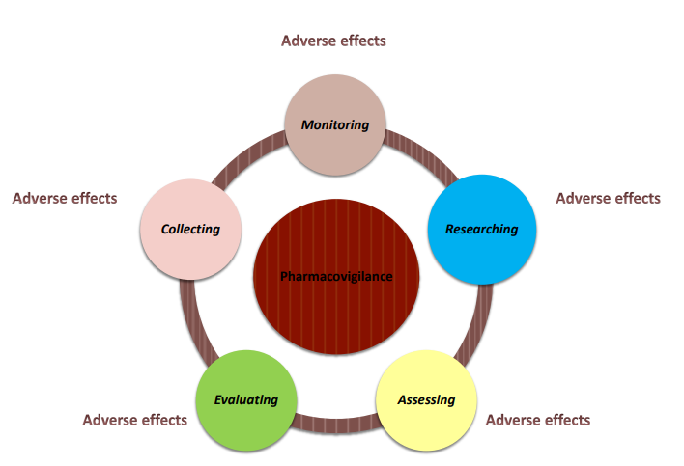

Slide 5
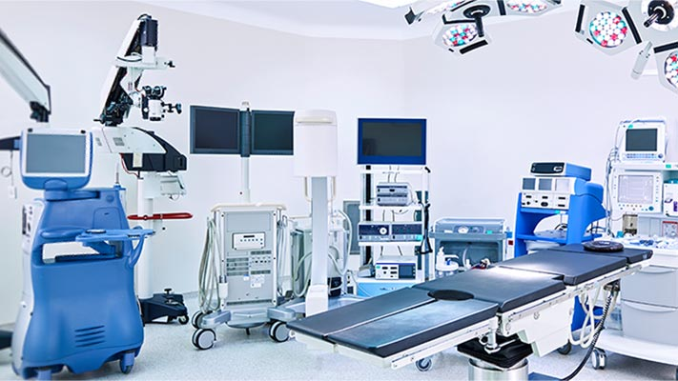
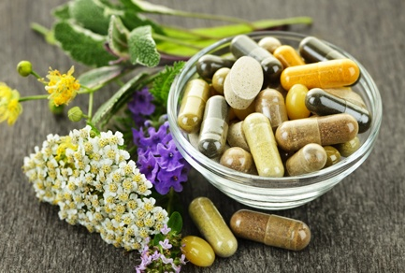
Pharmacovigilance (Contd.)
Recently, its concerns have been widened to include:
Herbals
Traditional and complementary medicines
Blood products
Biologicals
Medical devices
Vaccines.

Slide 6
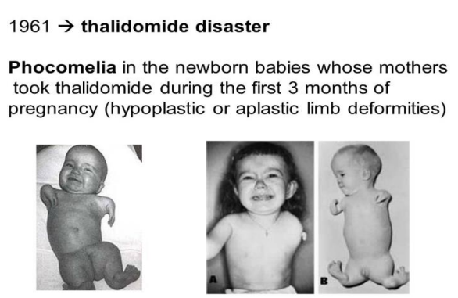
The Triggers 1. Thalidomide Tragedy Disaster

Slide 7
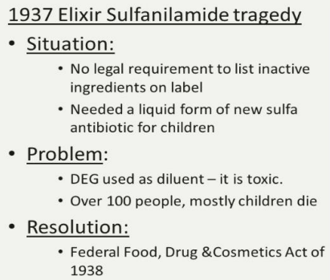
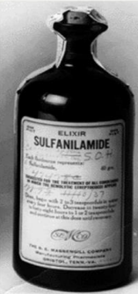
2. 1937 Elixir Sulfanilamide Tragedy
Because of this act companies were required to prove their products are safe before marketing!

Slide 8

Aims
Improve patient care and safety
Improve public health and safety
Contribute to the assessment of benefit, harm, effectiveness and risk of medicines, encouraging their safe, rational and more effective (including cost-effective) use,
Promote understanding, education and clinical training in pharmacovigilance and its effective communication to the public

Slide 9
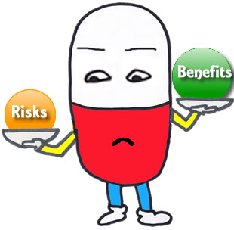

Why Pharmacovigilance?
To prevent the preventable harm due to drugs!
To ensure Benefit of medicines outweigh Risk safeguarding health of human population

Slide 10

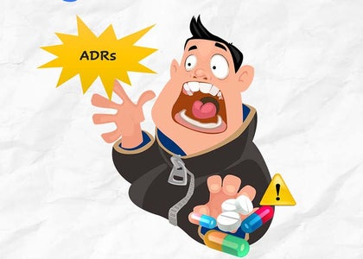
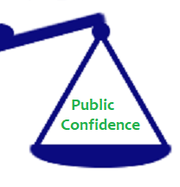

Why Pharmacovigilance? (Contd)
Humanitarian Concern
ADRs are expensive
Promoting rational use of medicine & adherence
Ensuring public confidence
Ethics

Slide 11

Why Pharmacovigilance Is Needed In Every Country?
Because of differences in:
Drug production
Distribution and use
Genetics , diet, traditions of the people
Pharmaceutical quality and composition (active & inactive ingredients)

Slide 12
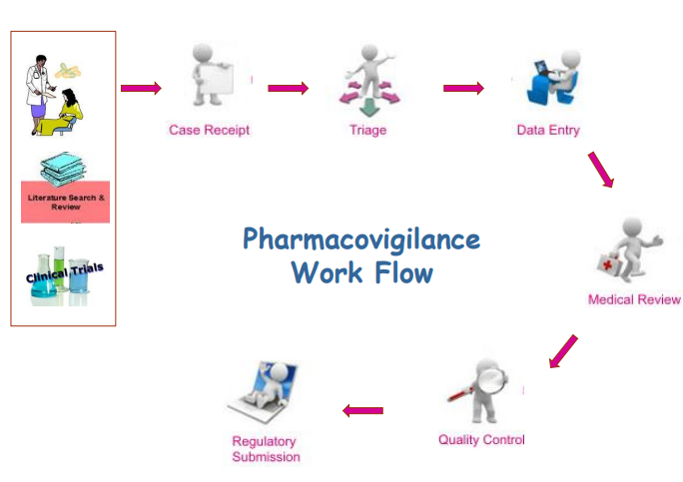

Slide 13

Pharmacovigiilance Programme Of India (Pvpi)
The Central Drugs Standard Control Organization (CDSCO), Directorate General of Health Services under the aegis of Ministry of Health & Family Welfare, (GOI) in collaboration with Indian Pharmacopeia commission, Ghaziabad has initiated a nation-wide Pharmacovigilance programme for protecting the health of the patients by assuring drug safety.

Slide 14
Goals & Objectives
Goal: To ensure that the benefits of use of medicine outweighs the risks and thus safeguard the health of the Indian population.
Objectives:
* To monitor Adverse Drug Reactions (ADRs) in Indian population.
* To create awareness amongst health care professionals about the importance of ADR reporting in India
* Support the CDSCO for formulating safety related regulatory decisions for medicines
* Create a national centre of excellence at par with global drug safety monitoring standards

Slide 15

UMC (Uppsala Monitoring Centre)
World Health Organization Collaborating Centre for International Drug Monitoring.
Headquarters- Uppsala, Sweden.
UMC operates the technical and scientific aspects of the WHO’s worldwide pharmacovigilance network.
Within the program, the individual’s case report of suspected ADRs are collected and stored in common database called Vigiflow.

Slide 16
UMC (contd.)
UMC’s main tasks:
Improve worldwide patient safety & welfare by reducing the risk of medicines.
2. Collect & analyze ICSRs worldwide.
3. Communicate potential patient safety issues.
4. Actively support & provide training in PV.
5. Develop the science & practice of PV.

Slide 17
Causality Assessment
WHO Scale
Naranjo Scale

Slide 18
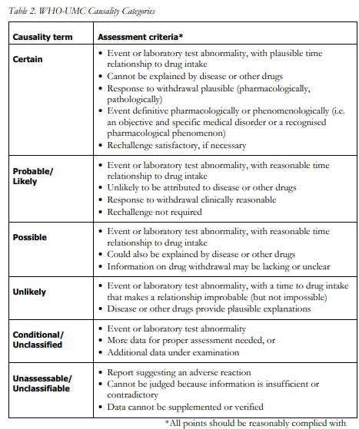
WHO
Assessment
Scale
Notes:
Adverse drug reaction (ADR) monitoring involves following steps 1. Identifying adverse drug reaction (ADR). 2. Assessing causality between drug and suspected reaction by using various algorithms. 3. Documentation of ADR in patient’s medical records. 4. Reporting serious ADRs to pharmacovigilance centres /ADR regulating authorities

Slide 19
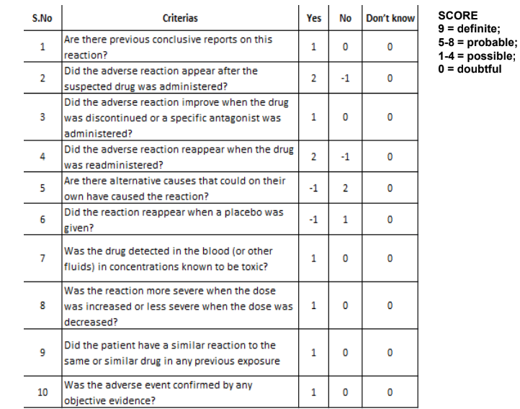
Naranjo Scale

Slide 20
Research on side effects of medicines
Because dying due to a disease is at times is unavoidable !
But dying due to adverse drug reactions is totally unacceptable!!

Slide 21

References
https://ccrps.org/clinical-research-blog/introduction-to-pharmacovigilance
https://www.who.int/teams/regulation-prequalification/regulation-and-safety/pharmacovigilance

Slide 22


